Slide 1
HHS Data Architecture:
Enterprise Conceptual Data Model Review
Gary Anderson, Erik Kuiler, Stan Vornovitsky
HHS Enterprise Architecture PMO
FHIMS WG - Weekly IM Project Call
20 November 2009

Slide 2
Agenda
Purpose
Method
Sources of Information
Example ORM Model
Superordinate ECDM
Detail-Level ECDM
Guidelines
Next Steps
Questions

Slide 3
Purpose of the HHS ECDM
Consistent Conceptual Representation of HHS Information Resources
  Objects
    Identity and characteristics
  Interdependencies
    Objects and their roles formulated as predicates
Foundation for Further Data Architectural Efforts
  Business information concepts
  Ontology (identity, characteristics, and relationships)
  Syntax and correlation rules
Template for Data Architecture Federation
  ECDM ← CDM ← LDM; ECDM ← CDM ← IEP
Notes:
Transform
Analyze business artifacts: policies, procedures, forms, documents
Extrapolate DA artifacts: subject areas, communities of interest, Business Rules, data objects, attributes, and relationships
Model DA as (a) predicates and (b) graphics

Slide 4
Method for Deriving the HHS ECDM
Object Role Model (ORM)
  Focus on the ontological aspects of information
    Objects and the
    Roles (assigned parts) they play in
    Relationships
Natural Language Predicates
  Focus on simply formulated statements that describe the essential nature of the enterprise in terms of:
    Identifiable information concepts used in the enterprise
    Inter- and Intra-conceptual relationships (e.g., identification, description, collaboration, agency, and means)

Slide 5
Sources of Information
HHS Enterprise Architecture – Enterprise Conceptual Data Model: An Overview, Version 0.01. 15 December 2008:
  DAWG HEAR Analysis of Data Objects, Appendix C Data Categories
  EA Repository of CMS EA Objects
  NIH Conceptual Model
  FDA Forms 2656 and 2657

Slide 6
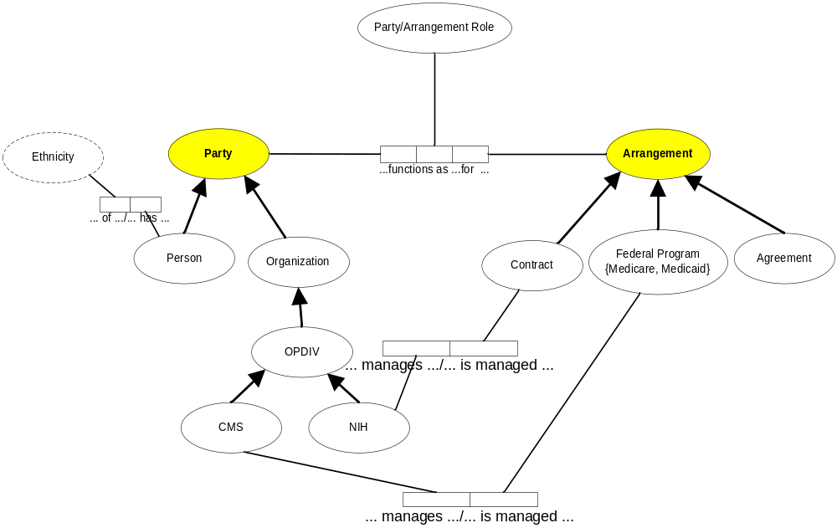
Example ORM Model

Slide 7
Example ORM-based Predicates
<Person> is a type of <Party>
<Organization> is a type of <Party >
<OPDIV> is a type of <Organization>
<CMS> is a type of <OPDIV>
<NIH> is a type of <OPDIV>
<CMS> manages <Federal Program>;
alternatively <Federal Program> is managed by <CMS>
<NIH> manages <Contract>;
  alternatively <Contract> is managed by <NIH>
<Person> has <Ethnicity>;
  alternatively <Ethnicity> of <Person>

Slide 8
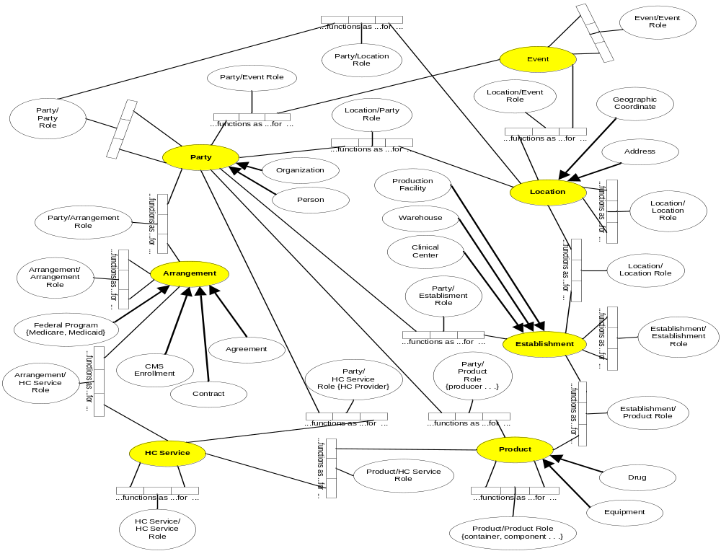
Superordinate ECDM: Prime Objects, Roles and Relationships

Slide 9
Superordinate ORM-based Predicates (1)
<Organization> is a type of <Party>
<Person> is a type of <Party>
<Address> is a type of <Location>
<Production Facility> is a type of <Establishment>
<Warehouse> is a type of <Establishment>
<Clinical Center> is a type of <Establishment>
<Federal Program> is a type of <Arrangement>
<Contract> is a type of <Arrangement>
<Equipment> is a type of <Product>
<Drug> is a type of <Product>

Slide 10
Superordinate ORM-based Predicates (2)
<Party1> functions as <Party/Party Role> for <Party 2>
<Party> functions as <Party/Location Role> for <Location>
<Party> functions as <Party/Event Role> for <Event>
<Party> functions as <Party/Establishment Role> for <Establishment>
<Party> functions as <Party/Product Role> for <Product>
<Party> functions as <Party/HC Service Role> for <HC Service>
<Party> functions as <Party/Arrangement Role> for <Arrangement>
<Arrangement1> functions as <Arrangement/Arrangement Role> for <Arrangement2>
<Arrangement1> functions as <Arrangement/HC Service Role> for <HC Service>
<HC Service1> functions as <HC Service/ HC Service Role> for <HC Service2>

Slide 11
Superordinate ORM-based Predicates (3)
<Product> functions as < Product/HC Service Role> for <HC Service>
<Product1> functions as < Product/Product Role> for <Product2>
<Establishment> functions as <Establishment/Product Role> for <Product>
<Establishment1> functions as <Establishment/Establishment Role> for <Establishment2>
<Location> functions as < Location/Establishment Role> for <Establishment>
< Location1> functions as < Location/Location Role> for <Location2>
<Party> functions as <Party/Arrangement Role> for <Arrangement>
<Location> functions as <Location/Party Role> for <Party>
<Address> is a type of <Location>
<Geographical Coordinate> is a type of <Location>
<Event1> functions as <Event/Event Role> for <Event2>

Slide 12
Detail-level ECDM: Objects, Roles, Relationships, and Predicates
Detail-level ECDM is an elaboration of the Superordinate ECDM
Correlation Guidelines:
  Objects defined in models developed at lower levels of abstraction must correlate with objects defined in models at higher levels of abstraction
  Object defined in models developed at higher levels of abstraction may be inherited verbatim by models developed at lower levels of abstraction.
  Superordinate role objects may be decomposed at lower levels into qualified objects and relationships

Slide 13
Correlation Example (1)
# 16 <Party> functions as <Party/HC Service Role> for <HC Service>
  Subtype of <Party>: {Person, Organization}
  Subtype of <Organization>: <OPDIV>
  Subtype of <OPDIV>: {CMS, FDA, NIH…}
  Domain of <Organization>: {HC Provider…}
  Domain of <Party/HC Service Role>: {designator, evaluator…}
In the detail-level ECDM predicate this predicate becomes:
  <HC Provider> is designated by <CMS> to provide <HC Service> based on <HC Provider Eligibility Criterion>

Slide 14
Correlation Example (2)
#15 <Party> functions as <Party/Product Role> for <Product>
  Subtype of <Party>: {Person, Organization}
  Subtype of <Organization>: <OPDIV>
  Subtype of <OPDIV>: {CMS, FDA, NIH…}
  Domain of <Party/Product Role>: {tester, distributor, evaluator…}
In the detail-level ECDM this predicate becomes:
  <FDA> tests <Product> for <Product Compliance> based on <Product Test Protocol>

Slide 15
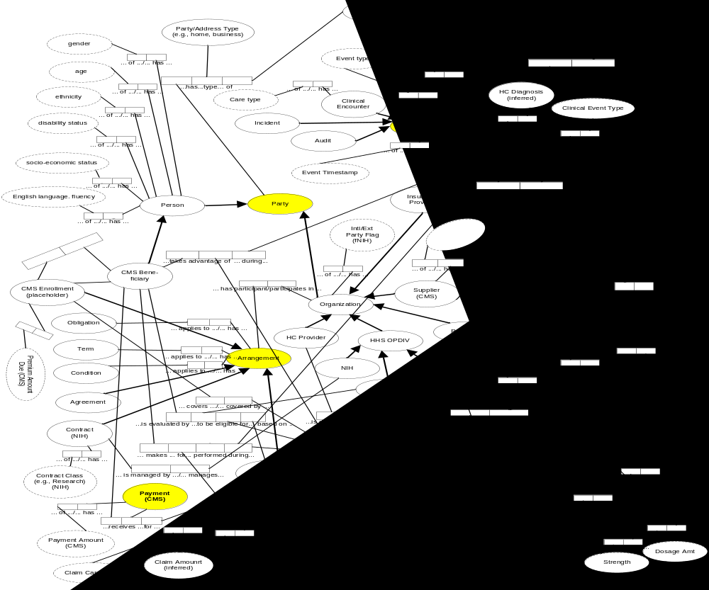
Detail-Level ECDM

Slide 16
Detail-Level ECDM Predicates (1)
<Audit> is a type of <Event>
<Agreement> is a type of <Arrangement>
<Claim> has <Claim Amount>
<Claim> has <Claim Care Class>
<Clinical Center> is a type of <Establishment>
<Clinical Encounter> has <Care Type>
<Clinical Encounter> is a type of <Event>
<Clinical Event> has <Clinical Event Type>
<Clinical Event> is a type of <Event>
<Clinical Event> occurs at a <Clinical center>
<CMS> is an <OPDIV>
<CMS> manages <Federal Program>
<CMS Beneficiary> applies for <CMS Enrollment>
<CMS Beneficiary> is a type of <Person>
<CMS Beneficiary> is evaluated by <CMS> to be eligible for <HC Service> based on <HC Beneficiary Eligibility Criterion>
<CMS Beneficiary> makes <Claim> for <HC Service> performed during <Clinical Event>
<CMS Beneficiary> receives <Payment> for <Claim>
<CMS Beneficiary> takes advantage of <HC Service> during <Clinical event>
<CMS Enrollment> covers <HC Service>
<CMS Enrollment> has <Premium Amount Due>

Slide 17
Detail-Level ECDM Predicates (2)
<CMS Enrollment> is a type of <Arrangement>
<Condition> applies to <Arrangement>
<Contract> has <Contract Class>
<Contract> is a type of <Arrangement>
<Drug> has <Dosage Amount>
<Drug> has <Federal Rebate Amount>
<Drug> has <Federal Upper Limit Price Amount>
<Drug> has <Strength>
<Drug> is a type of <Product>
<Drug Test Protocol> is a type of <Product Test Protocol>
<Drug Usage Direction> applies to <Drug>
<Equipment> is a type of <Product>
<Equipment Test Protocol> is a type of <Product Test Protocol>
<Establishment> is located at <Location>
<Event> has <Event Class>
<Event> has <Event Timestamp>
<Event> has <Event Type>
<Event> occurs at <Location>
<FDA> is an <OPDIV>
<FDA> tests <Product> for <Product Compliance> based on <Product Test Protocol>

Slide 18
Detail-Level ECDM Predicates (3)
<Federal Program> is a type of <Arrangement>
<Federal Program> supports <HC Service>
<HC Diagnosis> is the result of a <Clinical Event>
<HC Provider> is designated by <CMS> to provide <HC Service> based on <HC Provider Eligibility Criterion>
<HC Service> benefits from <Product>
<HC Provider> is a type of <Organization>
<HHS OPDIV is a type of <Organization>
<Incident> is a type of <Event>
<Mammography Equipment> is a type of <Medical Equipment>
<Mammography Equipment Certification> is a type of <Product Compliance>
<Medical Equipment> is a type of <Product>
<NIH> is an <OPDIV>
<NIH> manages <Contract>
<Obligation> applies to <Arrangement>
<Organization> has <Internal/External Party Flag>
<Organization> is a type of <Party>
<Organization> participates in <Arrangement>
<Party> has a <Party/Address Type> of <Address>
<Payment> has <Payment Amount>
<Person> has <Age>

Slide 19
Detail-Level ECDM Predicates (4)
<Person> has <Disability Status>
<Person> has <English Language Fluency>
<Person> has <Ethnicity>
<Person> has <Gender>
<Person> has <Socio-Economic Status>
<Person> is a type of <Party>
<Producer> is a type of <Organization>
<Producer> makes <Product> at <Production Facility>
<Product> functions as <Product/Product Role> for <Product>
<Product> has <Average Manufacturer's Price>
<Product> has <Best price>
<Product> has <Import/Export Flag>
<Product> has <Packaging Specification>
<Production Facility> is a type of <Establishment>
<Supplier> has <NPI>
<Supplier> is a type of <Organization>
<Supplier> stores <Product> at <Warehouse>
<Term> applies to <Arrangement>
<Warehouse> is a type of <Establishment>

Slide 20
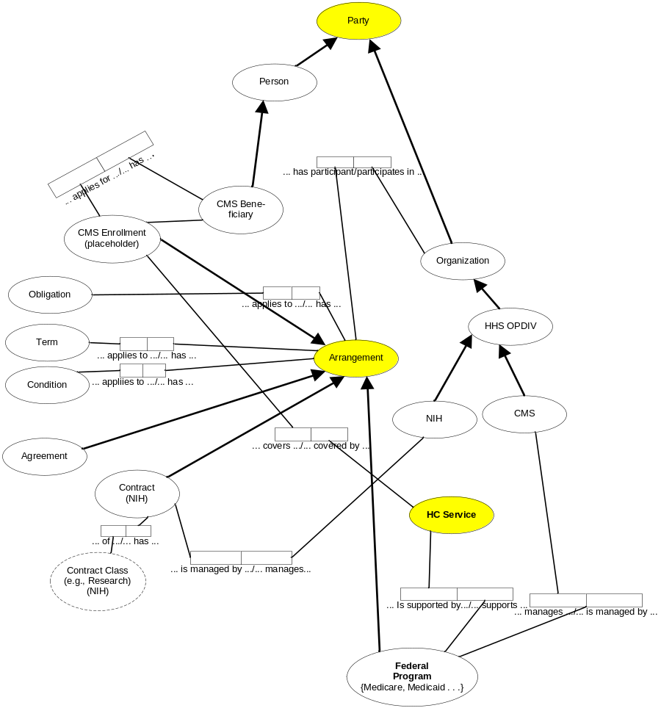
ECDM Partition: Arrangement Perspective

Slide 21
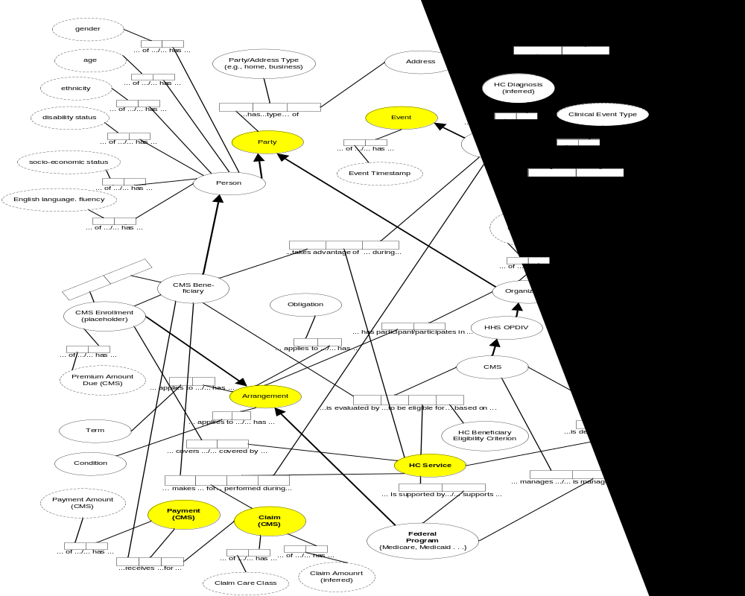
ECDM Partition: Beneficiary Perspective
Notes:
Examples of customer-oriented partitions:
Timesheet
Invoice
Service-oriented Architecture as federated database (individual autonomy and self-governance)

Slide 22
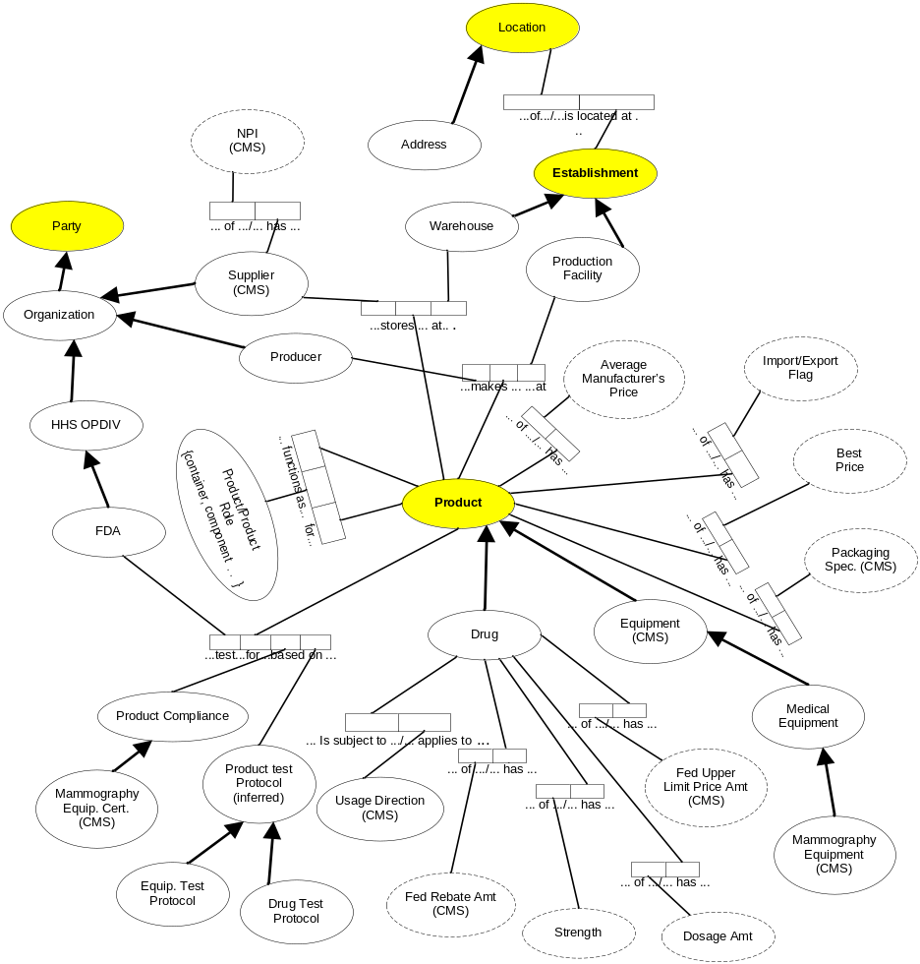
ECDM Partition: Product Perspective

Slide 23
ECDM-CDM Expansion and Correlation Guidelines: Objectives
Mitigation of Semantic Heterogeneity
  Consistent interpretation
    Concise name
    Alias names, if any
    Understandable definition
    Domain of values, if appropriate
Mitigation of Closed World Assumption
  Inclusion of new facts as objects, roles, and relationships, formulated as predicates

Slide 24
ECDM-CDM Expansion and Correlation Guidelines: Method
Object Mappings
  CDM object ≡ ECDM object
  Synonym reconciliation
    Established as subtype objects – delineated by qualifiers if necessary – and mapped to global objects (i.e., type-subtype hierarchies)
    Subsumed as alias names of other objects
  Homonym reconciliation
    Noted as alias names of other objects
Predicate Mappings
  CDM predicate ≡ ECDM predicate
  CDM predicate informs ECDM predicate (e.g., to reflect the addition of CDM-based objects as subtypes of an ECDM object)
ECDM Expansion
  Addition of new objects to denote new facts
  Addition of subtype objects
  Addition of predicates to reflect addition of new facts

Slide 25
ECDM/CDM-LDM Correlation Guidelines: Objectives
Consistent, Line-of-Sight Traceability
Syntactic Consistency
Semantic Consistency

Slide 26
ECDM/CDM-LDM Correlation Guidelines: Method
Disaggregation and Parsing
  Addition of detail
  Syntactic transformation
Object Mapping
  LDM objects map to ECDM/CDM objects
    LDM entity ≡ ECDM/CDM conceptual object
    LDM entity is a refinement of ECDM/CDM object
    LDM entity is an extension of ECDM/CDM object
    LDM attribute is a refinement of ECDM/CDM object
      Establishes an identity
      Denotes a characteristic
Predicate Mapping
  LDM entity-relationships map to ECDM/CDM predicates
  ER Synthesis
    Mandatory and optional attributes
    Functional dependencies (inter- and Intra-entity links)

Slide 27
Next Steps: ECDM Development
Expand ECDM:
  OPDIV CDMs
  SDO Artifacts (e.g., HL7 RIM, NIEM)
  HHS Information Exchange Packages

Slide 28
Next Steps: Integration with SDO Data Models
Guidelines (as predicates):
  <SDO data entity> extends <HHS CDM data entity>
  <SDO data entity> is a subtype of <HHS CDM data entity>
  <HHS CDM data entity> incorporates <SDO data entity>
  <HHS CDM entity> incorporates <SDO data element>
  <SDO data entity> is alias of <CDM data entity>
  <SDO data element> is alias of <CDM data element>
  <SDO information concept> become <SDO entity>

Slide 29
Next Steps: Integration with SDO Data Models (cont.)
Examples:
SDO Data Model contains entity <Patient>
  ECDM contains entities <PERSON> and <PARTY>
        <Patient> is a subtype of <PERSON>
        <PERSON> is a subtype of <PARTY>
SDO Data Model contains entity <Patient Visit>
        <Patient Visit> is a subtype of <EVENT>
        <Patient Visit Date> is an alias of <EVENT Date>
Applicable guidelines
Applicable guidelines

Slide 30
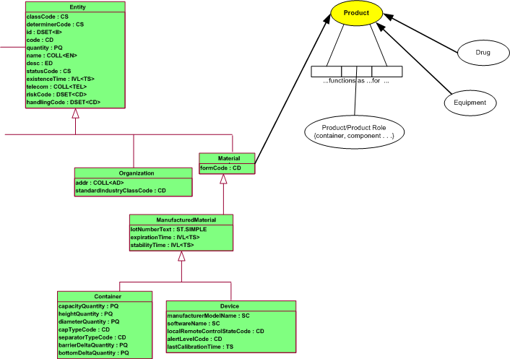
Next Steps: Integration with SDO Data Models (cont.)
Example:
HL7 RIM
HHS ECDM

Slide 31
Questions?
Points of contact:
Gary Anderson
Gary.Anderson@hhs.gov
Erik Kuiler (Data Architecture)
Erik.Kuiler@hhs.gov
Stan Vornovitsky (“Information Sharing Environment” Segment)
Stan.Vornovitsky@hhs.gov

